Slide 1
Communities in Canada Past and Present New France and British North America
April 4

Slide 2
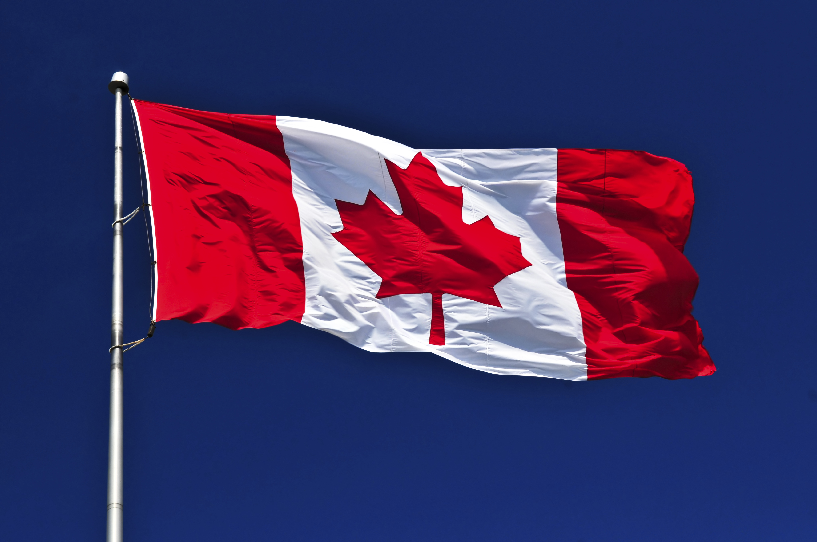
Canadian Symbols
https://www.historicacanada.ca/content/heritage-minutes/flags?media_type=41&media_category=29
What does our flag represent?

Slide 3
Placemat Activity
What symbols, words, and phrases are part of Canada’s identity?

Slide 4
Grade 7 Inquiry Project
5-10 minute Google Slides presentation
Explain: who, what, when, where, why, and how
Explain the Historical Perspective of the British, French, and First Nations
Analyze the significance of this event in Canada during this time period

Slide 5
Topic Selection

Slide 6
Canadian Identity Mind Map
https://www.mindmup.com/#m:g10B2eZeCnqIyFETjZ6VGhYTnpNYW8

Slide 7
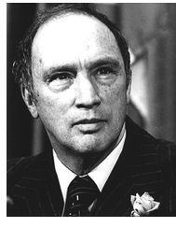
No All-Canadian Boys or Girls
“Uniformity is neither desirable nor possible in a country the size of Canada. We should not even be able to agree upon the kind of Canadian to choose as a model, let alone persuade most people to emulate it. There are few policies potentially more disastrous for Canada than to tell all Canadians that they must be alike. There is no such thing as a model or ideal Canadian. What could be more absurd than the concept of an “all-Canadian” boy or girl? A society which emphasizes uniformity is one which creates intolerance and hate. A society which eulogizes the average citizen is one which breeds mediocrity. What the world should be seeking, and what in Canada we must continue to cherish, are not concepts of uniformity but human values: compassion, love, and understanding.”

Slide 9
Communities in Canada Past and Present New France and British North America
April 5

Slide 10
I am Canadian - video

Slide 11
“I am a Canadian” by Duke Redbird
Canadian poet
Journalist, activist, businessman, actor
Ojibwe from the Saugeen First Nation
1970, vice-president of the Native Council of Canada
1970’s, appeared at the Mariposa Folk Festival (Orillia)

Slide 12
Presentation Date Selection
Wednesday April 20
.
.
.
Thursday April 21
.
.
.
.
Tuesday April 26
.

