Slide 1
Literature Circles
March 29,2016

Slide 2
Literature Circles
https://www.youtube.com/watch?v=yVK9ZV-AinA

Slide 3
Literature Circles: Turn and Talk
What did you notice about the way the students shared, interacted, and behaved while discussing their novels?”
Notes:
Physical set-up
Responses to eachother

Slide 4
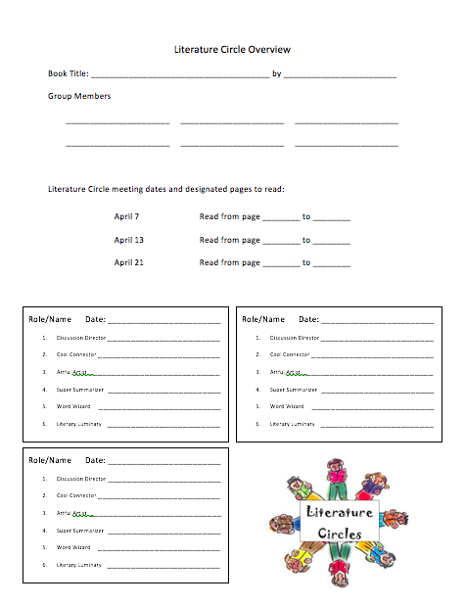
Overview
Each group will meet 3 times total
There will be 6 members of each group
Each week your roles will change

Slide 5
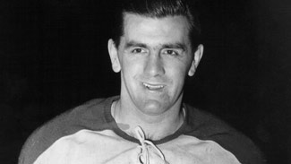
The Hockey Sweater
By Roch Carrier
Canadian Author
Published in French in 1979
Considered to be an iconic piece of Canadian Literature
Maurice ”Rocket” Richard
Montreal Canadians 1942-1960
18 seasons in the NHL
First player in history to score 50 goals in one season
First to reach 500 career goals

Slide 6
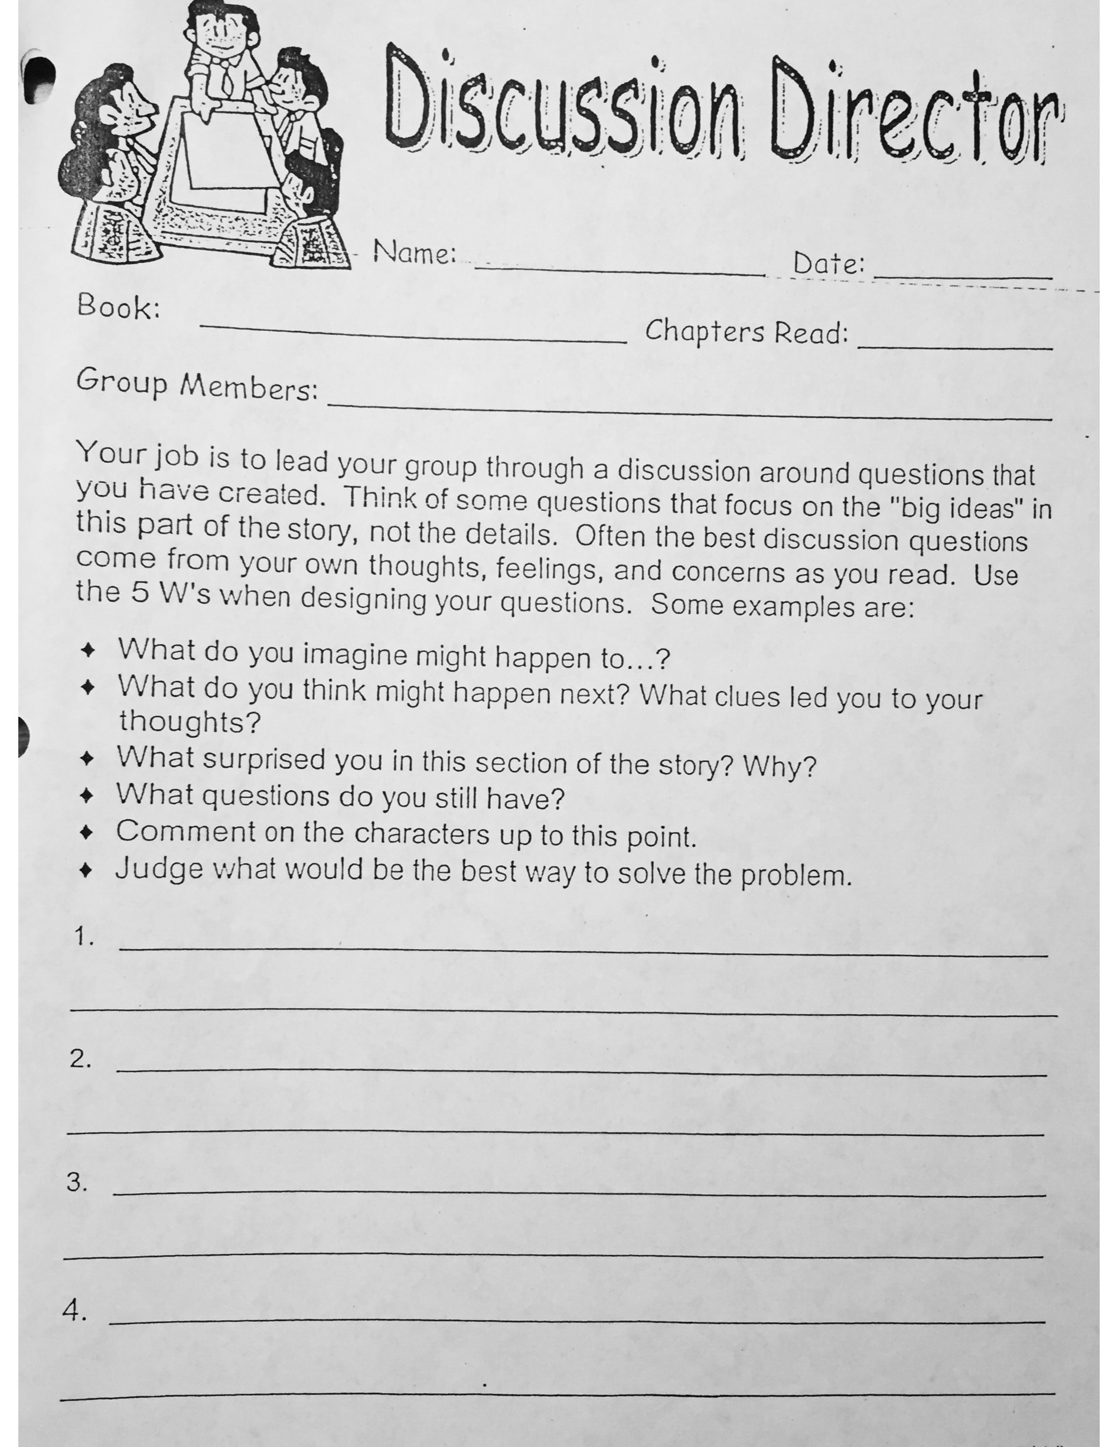
Role One: Discussion Director
The Discussion Director’s job is to create a list of questions involving BIG ideas that could be discussed with the group. These questions should be reflective and lead the discussion beyond the literal text.
“I wonder how… if… why… when… where…”

Slide 7
Success Criteria for the Discussion Director Role
How will I know I have completed my role?
I can act as a group leader within my circle.
I can focus on the BIG ideas of the story, not the small details.
I can design questions using the 5 W’s.

Slide 9
Literature Circles
March 30,2016

Slide 10
https://www.youtube.com/watch?v=EgydkfnUEi8

Slide 11
Role Two: Captain Connector
The Captain Connector’s job is to relate the text to other experiences in text (others books), real life (home, school, conversations, trips), or other subjects (science, social studies, math).
“This reminds me of… This makes me feel… This is the same as”

Slide 12
Success Criteria for the Captain Connector Role
How will I know I have completed my role?
I can make text to text connections
I can make text to self connections
I can make text to world connections
I can justify my connections

Slide 13
8-Box
Rough copies of each to be done in your journals.
Good copies to be done on the 8-Box paper.
Success Criteria
I can complete all sections
I can make my 8-box neat and visually appealing
I can use evidence from the text
I can use grammar, punctuation, full sentences, and proper spelling

Slide 14
Independent Novel Study: 8-Box
What I know + Information from the text
= my prediction
Prediction based on the front cover
Prediction based on the back cover
Prediction based on chapter 1.
Prediction later in the book

Slide 15
Persuasive Writing
March 30,2016

Slide 16
What does it mean to be persuasive?
Try to change someone’s mind
Try to be convincing
Why would someone want to be persuasive?
To change get something they want
To try to sell something

Slide 17
Characteristics of Persuasive Writing
Specific audience
Clear purpose
Supporting reasons
Persuasive word choice

Slide 18
Persuasion: Turn and Talk
What t.v. commercials or advertisements have you seen that are persuasive?
What aspect of those ads made them most effective?
Who was the intended audience of the ad?
https://www.youtube.com/watch?v=oMTjrrt2wAI

Slide 19
Sketcher’s Ad: Turn and Talk
Who is the intended audience for this ad?”
What is the purpose of this ad?
What are some of the supporting reasons this ad gives?
What are some examples of persuasive words used in this ad?

Slide 21
Literature circles
March 31

Slide 22
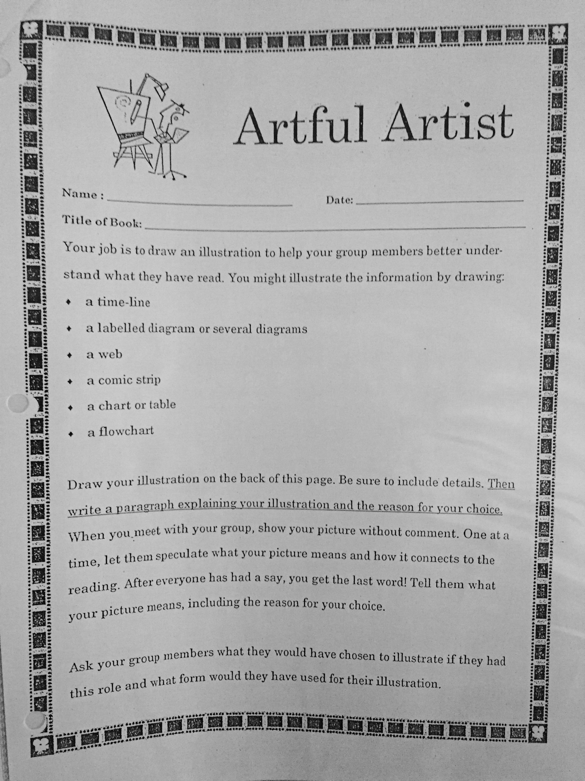
Role Three: Artful Artist
The Artful Artist’s job is to illustrate/sketch/make a labelled diagram to:
Highlight part of the text read (retell an interesting part, character, or setting)
Reflect upon what events might have occurred before the written text OR make a prediction (relate)

Slide 23
Success Criteria for the Artful Artist Role
How will I know I have completed my role?
I can create an illustration or diagram
I can choose a scene/character/event for better understanding of the text
I can explain the meaning of my picture and the reason for my choice

Slide 24
Artful Artist: Group Work
In groups of 3-4 create an illustration or diagram of a scene, character, or event from The Hockey Sweater
Individually, complete the written reflection about your image
Notes:
20 mins

Slide 25
Independent Reading, 8-Box

Slide 26
Persuasive writing
March 31

Slide 27
Characteristics of Persuasive Writing
Specific audience – Kids? Parents? Doctors? Families? Elderly? Men? Women?
Clear purpose – Selling? Convincing?
Supporting reasons – Price? Benefits?
Persuasive word choice – Only! Recommended! New!

Slide 28
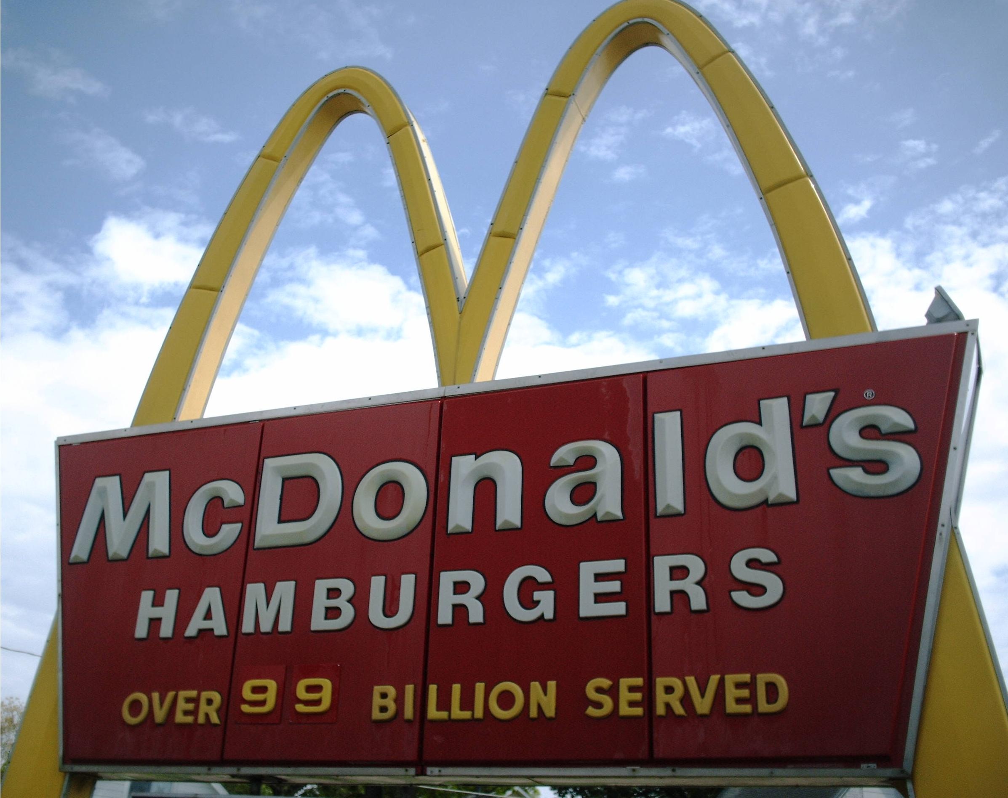
Bandwagon Advertisements
“Everyone has one!”
“Everyone is doing it!”
Are best-selling products necessarily better than others?

Slide 29
Testimonial Advertisements
Companies use a spokesperson to sell their product.
Spokesperson: someone who speaks on behalf of others
Why do advertisers use famous people in ads?

Slide 30
Glittering Generalities Advertisements
Generality: a word that is not specific
BETTER – Better than what?
MORE POWERFUL – Compared to what?
NEW, IMPROVED – How is it improved?
MOST POPULAR – Popular with who?

Slide 31
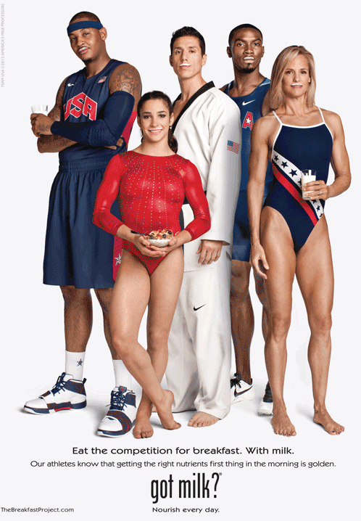
Slogans in Advertisements
Slogan: a catchphrase that you identify
with a product or company
Memorable
Positive

Slide 32
Persuasive Advertisements
What is the product or idea being sold?
Who do you think is the targeted audience?
What techniques (bandwagon, testimonial, glittering generalities, slogans) are used to capture the audience’s attention?

Slide 33
Group Work
Choose one advertisement
As a group, create an advertisement for the same product or idea, but target it toward a different audience
Answer these questions:
What product or idea is being sold?
Who is the targeted audience?
What techniques (bandwagon, testimonial, glittering generalities, slogans) did you use to capture the audience’s attention?

Slide 35
Literature circles
April 1

Slide 36
Group Work
Choose one advertisement
As a group, create an advertisement for the same product, but target it toward a different audience
Keep in mind:
Specific audience
Clear purpose
Supporting reasons
Persuasive word choice

Slide 37
Literature Circles: Predicting
What I know + Information from the text
= my prediction

Slide 38
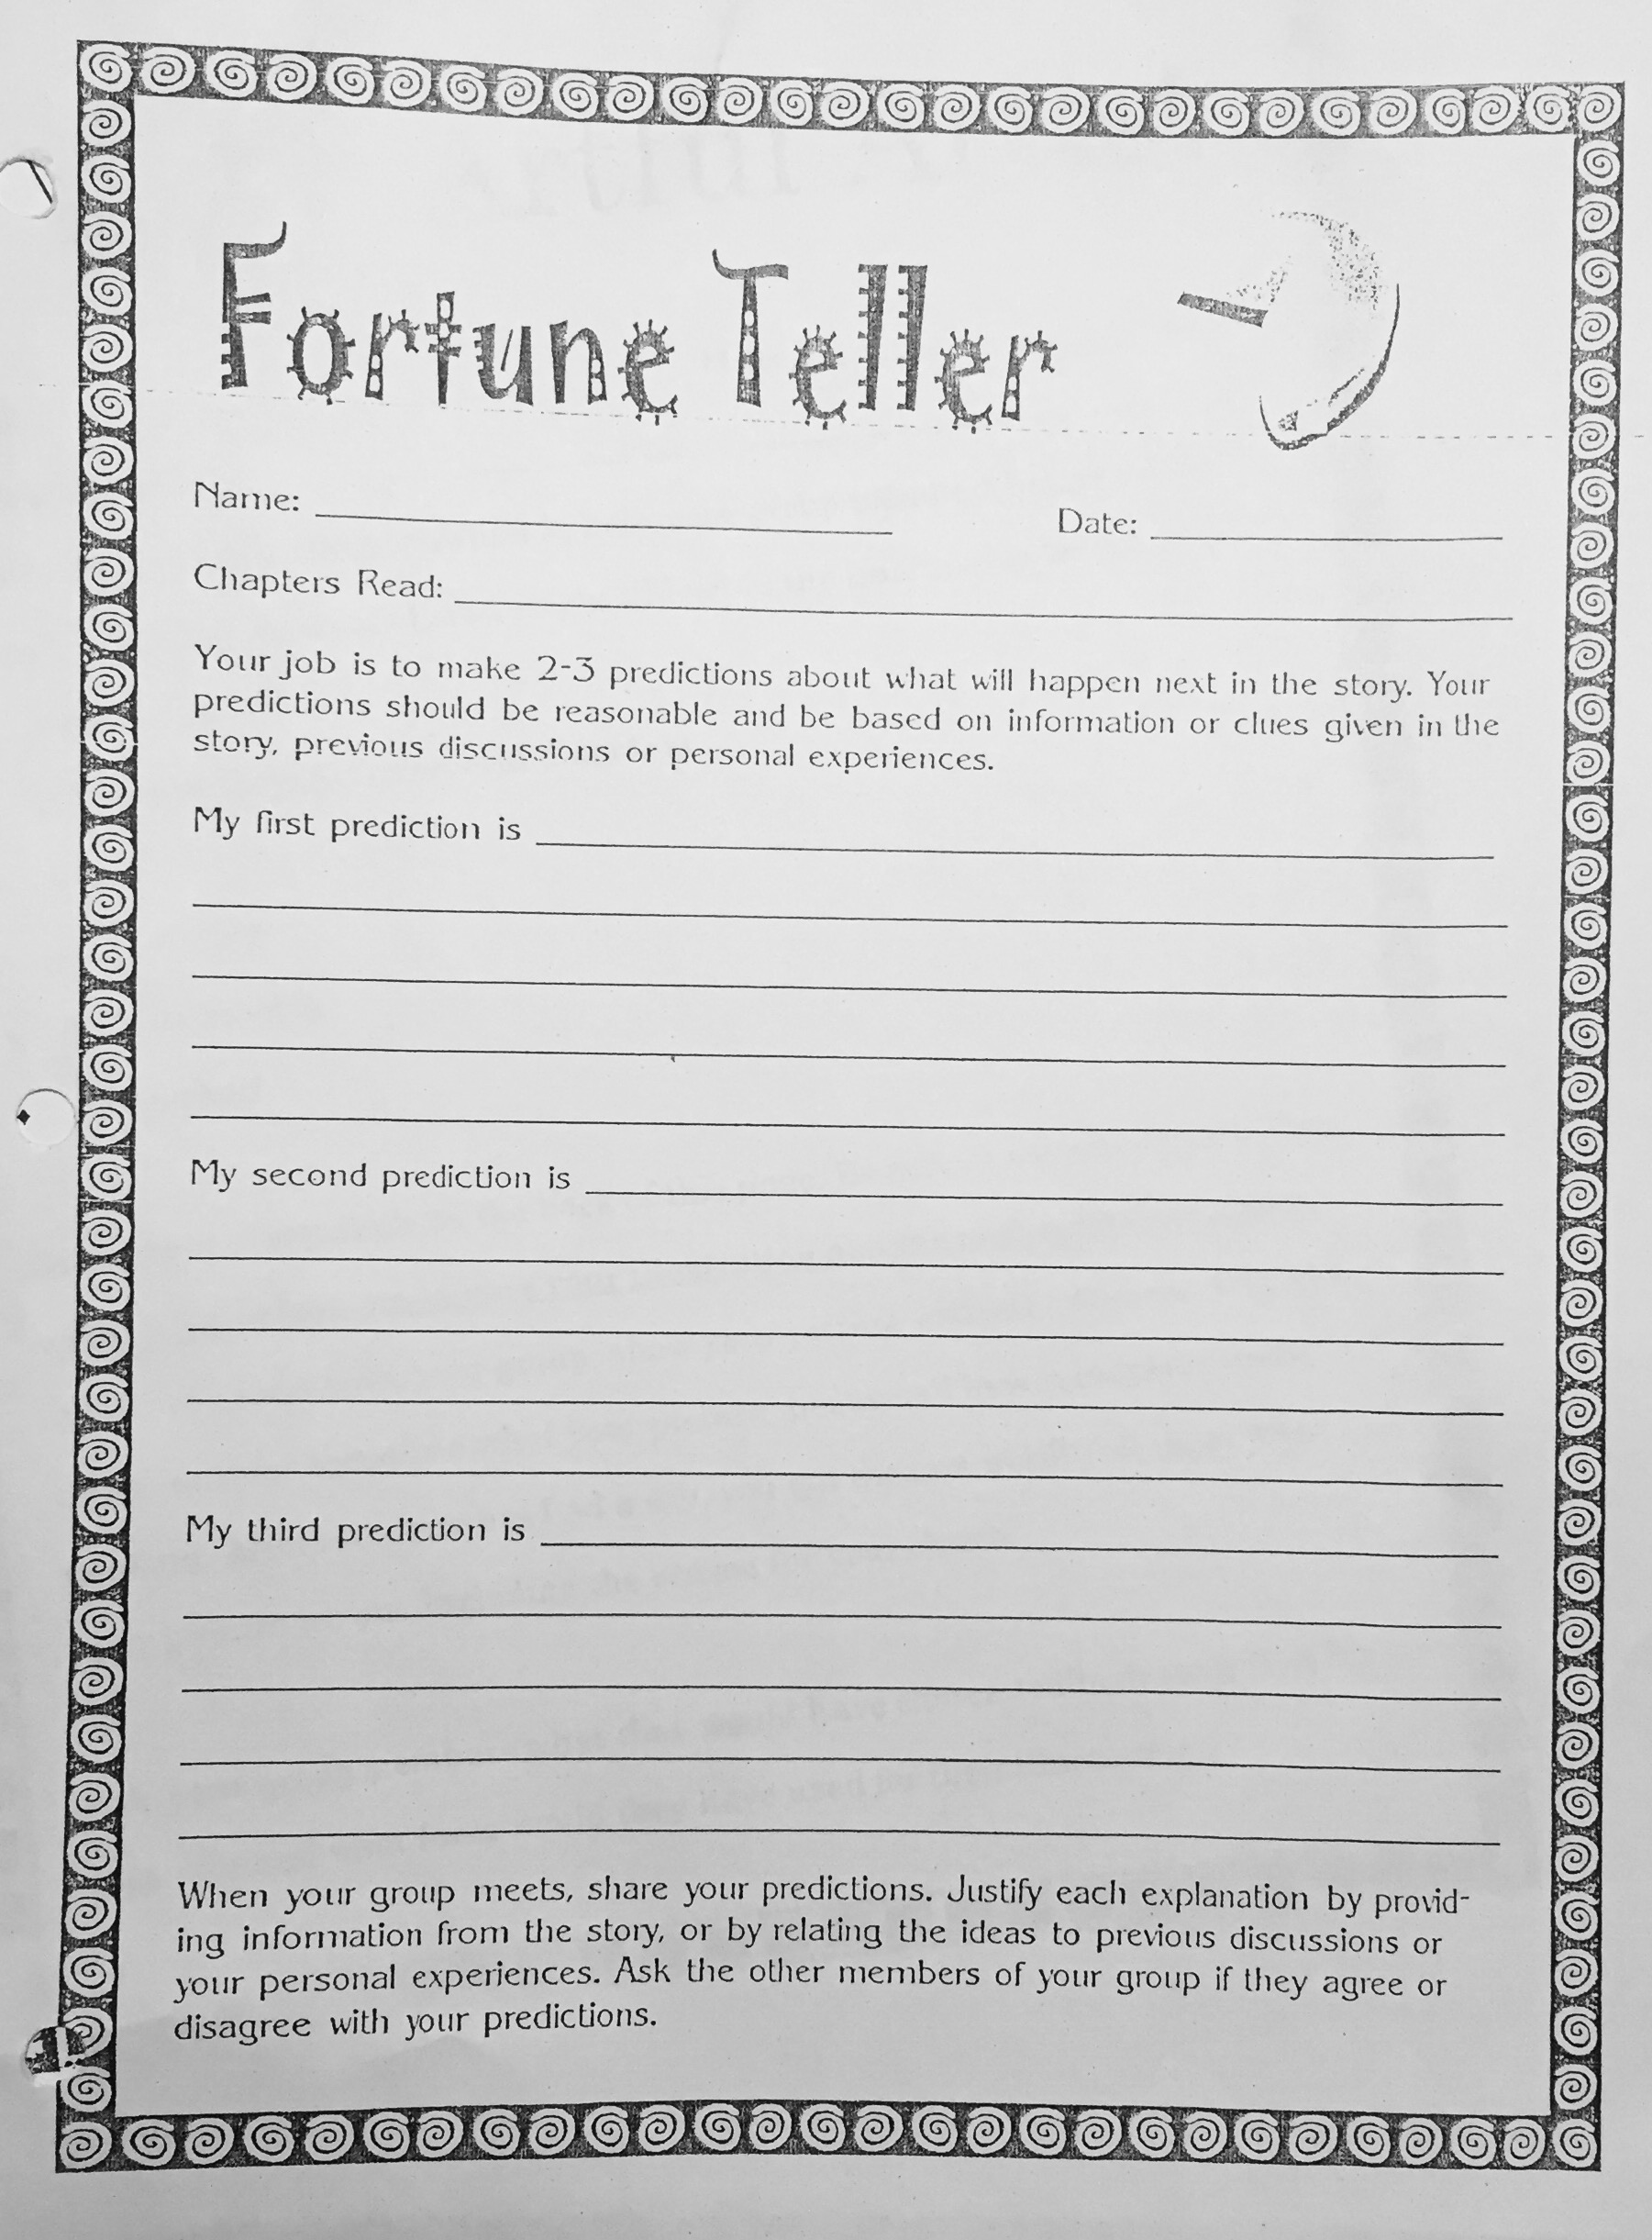
Role Four: Fortune Teller
The Fortune Teller’s job is to make predictions about what will happen next in the story. These predictions should reflect what has already happened in the story, and include evidence from the text.

Slide 39
Success Criteria for the Fortune Teller Role
How will I know I have completed my role?
I can create 2-3 predictions
I can justify my predictions with evidence from the text

Slide 41
Literature circles
April 4

Slide 42
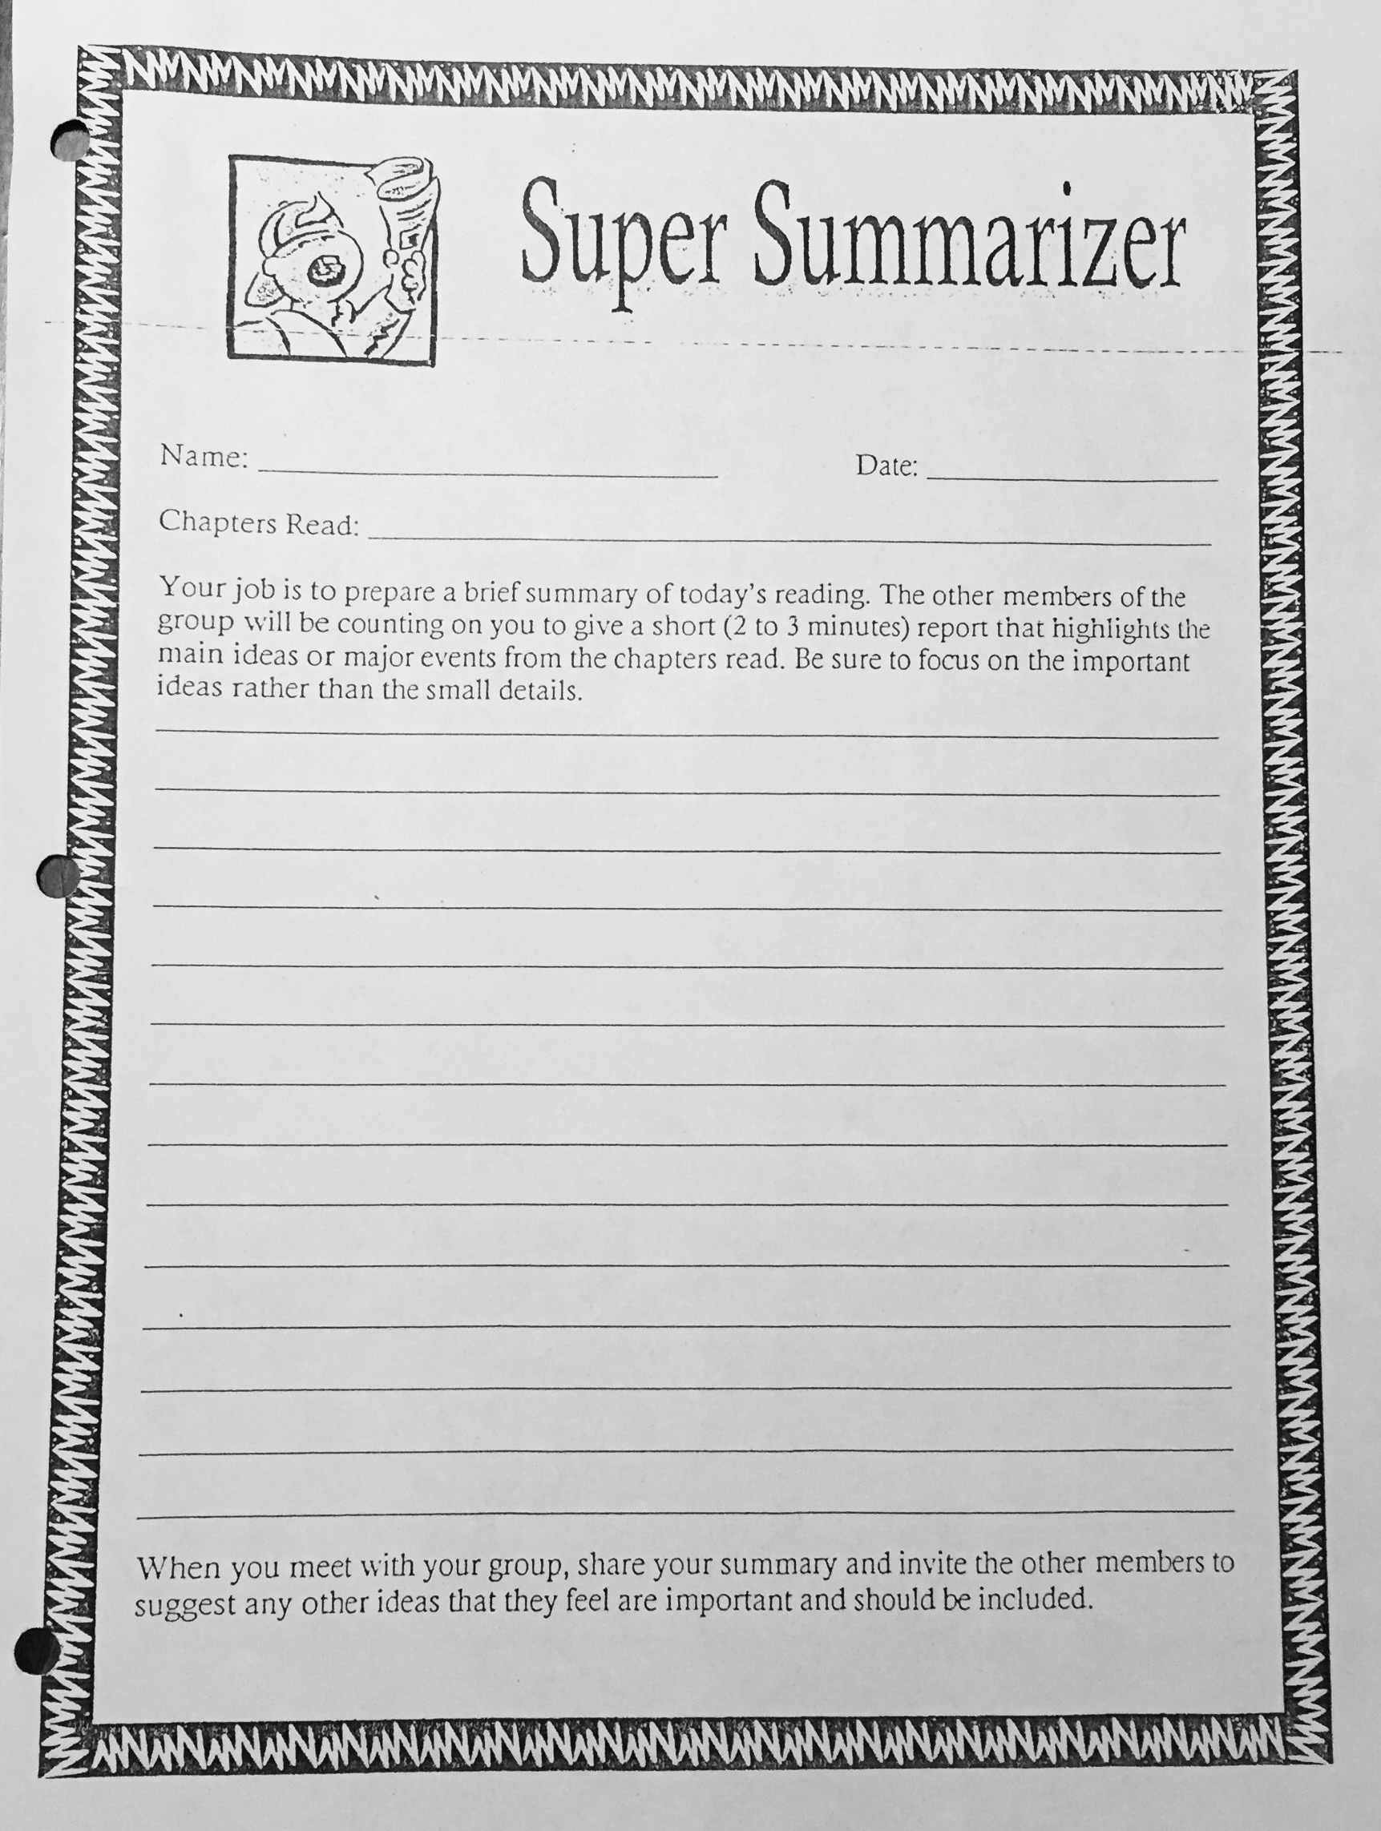
Role Five: Super Summarizer
The Super Summarizer’s job is to write a brief summary from the text highlighting the main ideas, major events, and/or key concepts that stress the gist of the material read (retell).

Slide 43
Success Criteria for the Super Summarizer Role
How will I know I have completed my role?
I can recount all important ideas and events from the text
I can discuss important areas of the text with my peers

Slide 44
Independent Reading, 8-Box

Slide 45
Persuasive writing
April 4

Slide 46
Point of View Profiles
On the First side complete a profile of yourself:
Physical appearance
Character qualities
Talents
Trade your sheet with a partner
Complete a Profile of your partner
Physical appearance
Character qualities
Talents

Slide 47
Point of View – Turn and Talk
“What two points of view do the profiles represent?”
“What is different about the profiles? What is the same?”
“Is there anything that surprises you? Is there anything your disagree with?”

Slide 48
In your journal…
Complete 3 separate paragraphs:
Here is how I see myself
Here is someone else’s view of me.
Here is how my pet views me

Slide 50
Literature circles
April 5

Slide 51
Role Six: Literary Luminary
The Literary Luminary’s job is to:
Select a few passages from the text (retell) to read aloud to the circle
Generate discussion around the significance (importance, interest, power, humour) of the passages (relate)
Invite predictions as to why the author chose to use those passages (reflect)

Slide 52
Success Criteria for the Literary Luminary Role
How will I know I have completed my role?
I can identify important areas of the text
I can read passages out loud clearly and with confidence (evidence of practice)
I can justify my selections and generate discussion

Slide 53
Title of Book: Harry Potter
The first part I chose is on page 394 .
“But you know, happiness can be found even in the darkest of times, if one only remembers to turn on the light.”
This section captured my interest because the author uses the symbol of a light-switch to represent positivity. This is an interesting idea because I have noticed that being positive usually helps during a bad situation. Do you think positive thinking can be turned on like a light-switch?
Your turn: Choose a passage from your independent novel that you think is important to the novel or would make for interesting group discussion

Slide 54
Short Group Meeting
You will have 5 minutes now to meet in your group and determine your roles for your first meeting on Thursday
Each person must:
Cooperatively select a role
Place their clothes peg on that role
Collect a copy of their story
You will need to spend the remainder of the period reading the story in preparation for your role sheet

Slide 56
OREO Writing
https://www.youtube.com/watch?v=_AG6js-KheQ

